Slide 1
Tableau Project
THIS PROJECT IS BASED ON COVID 19 ANALYSIS USING 2020-2021 COVID DATA.
THIS DATASETS CONSIST OF 2 WORKBOOK (COVID DEATHS AND COVID VACCINATIONS) AND I IMPORTED THIS DATA IN SQL SERVER MANAGEMENT STUDIO AND I CALCULATE THE FOLLOWING THINGS USING SQL QUERIES:
TOTAL CASES, TOTAL DEATHS, TOTAL DEATH PERCENTAGE, TOTAL DEATH COUNT PER CONTINENT, PERCENT POPULATION INFECTED PER COUNTRY, DATE WISE PERCENT POPULATION INFECTED PER COUNTRY.
AFTER CALCULATED THE ABOVE THINGS I EXPORTED THEIR OUTPUT INTO EXCEL AND THEN USE THOSE EXCEL FILES IN TABLEAU TO MAKE DASHBOARD.

Slide 2
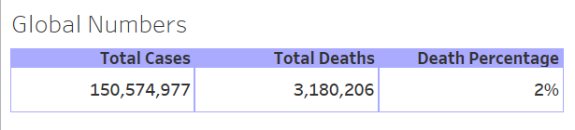
GLOBAL NUMBERS

Slide 3
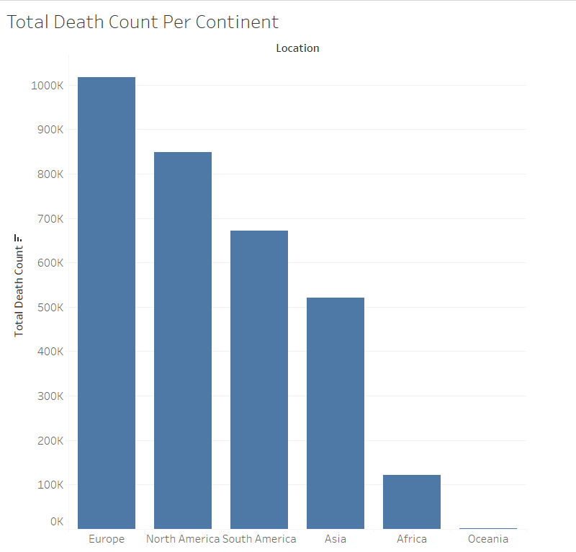
TOTAL DEATH COUNT PER CONTINENT

Slide 4
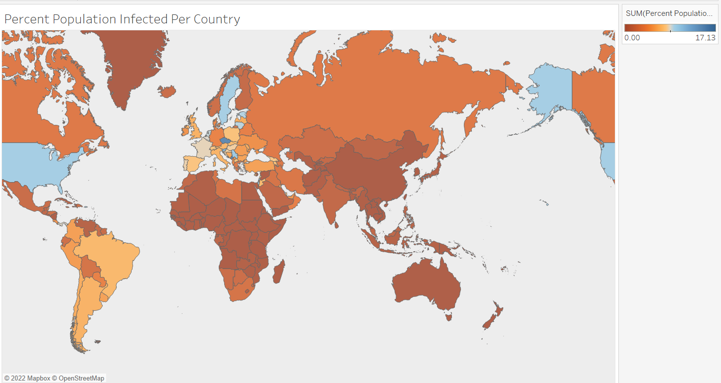
PERCENT POPULATION INFECTED PER COUNTRY

Slide 5
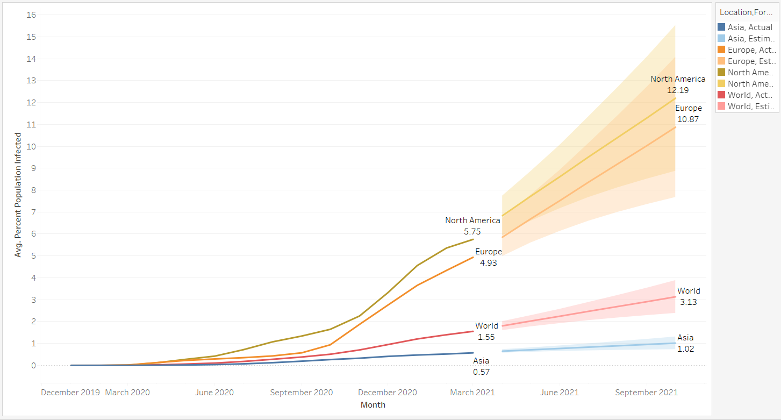
FORECAST

Slide 6
KEY INSIGHTS GENERATED:
MORTALITY RATE IS VERY LOW
DEATH COUNT HAVE NO SPECIFIC RELATION WITH COUNTRY POPULATION.
PERCENTAGE OF INFECTED POPULATION IS HIGHEST IN NORTH AMERICA AND FORECAST IS ALSO TELLING US SAME.

Slide 7
DASHBOARD

Slide 8
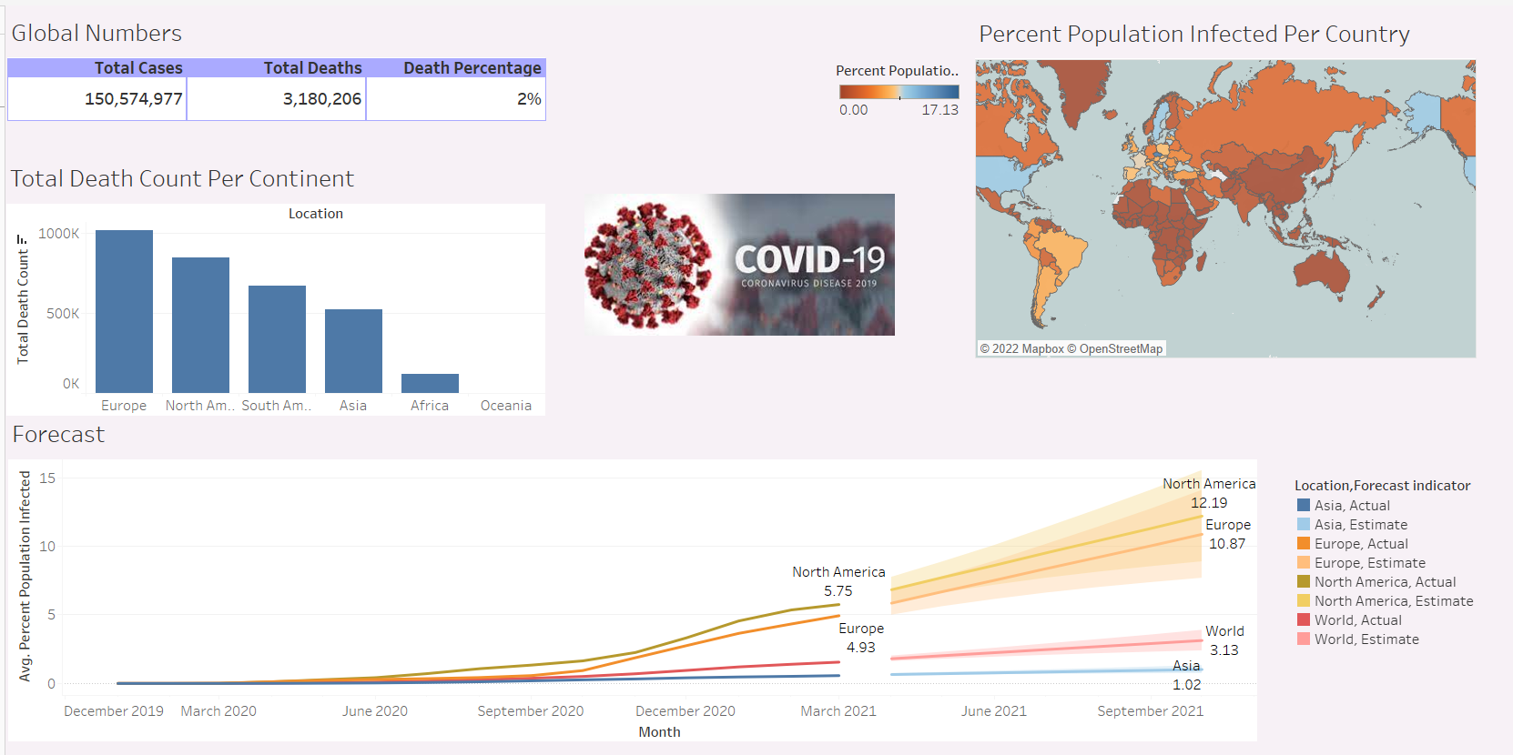

Slide 9
THANK YOU

